Slide 1
SUPPLIER PERFORMANCE

Slide 2
LIST OF CONTENTS
About
Entity Relationship Diagram
Supplier Performance Analysis
Conclusion

Slide 3
ABOUT
This project aims to create a Supplier Performance Dashboard that helps organizations monitor and evaluate vendors based on key metrics such as lead time, compliance records, and customer feedback.

Slide 4
BUSINESS FLOW DIAGRAM

Slide 5
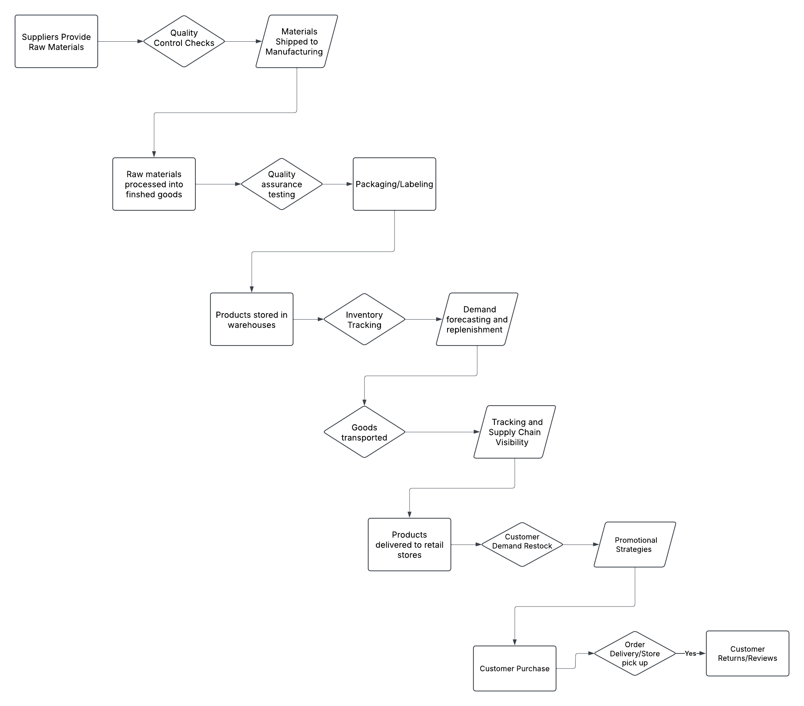

Slide 6

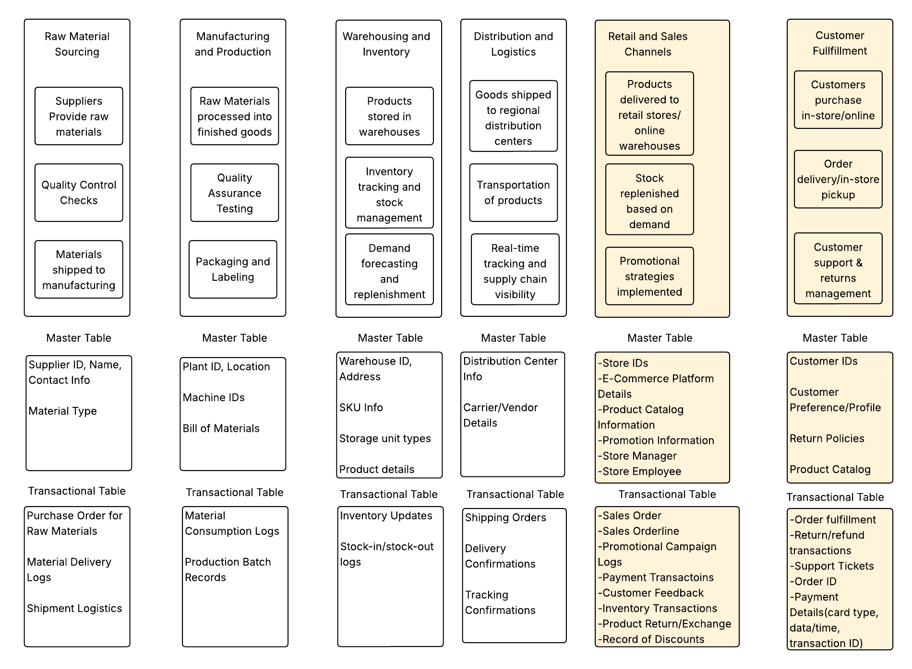





Slide 7
ENTITY RELATIONSHIP DIAGRAM

Slide 8
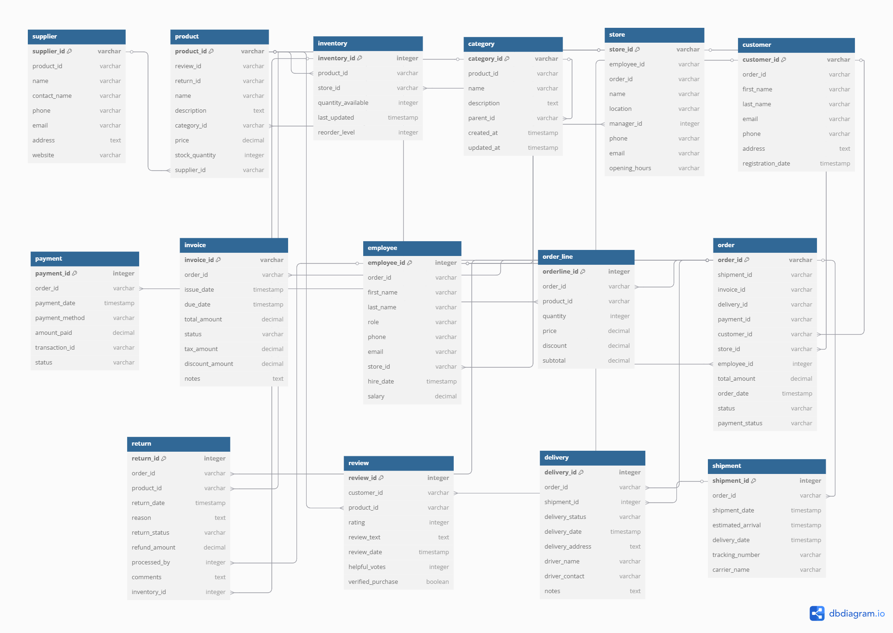

Slide 9
SUPPLIER PERFORMANCE ANALYSIS

Slide 10
https://app.powerbi.com/links/BBXIK7wqrT?ctid=8d281d1d-9c4d-4bf7-b16e-032d15de9f6c&pbi_source=linkShare&bookmarkGuid=eab74bae-192f-4877-abca-67b44df531f3

Slide 11
Conclusion
By Focusing on Supplier quality, Compliance, Lead time, we can make strategic decisions that improve our Operations, Reduced costs, and maximize profits. This dashboard provides the insights that we need to continuously improve supplier performance, ensuring that our company remains competitive and profitable in long run

